Slide 1
An Innovative Solution: AI-Based Digital Screen Integrated Tables for Educational Setting
Sagar Tamang & Dr. Dibya Jyoti Borah
The Assam Kaziranga University

Slide 2
Contents
Introduction
Background
Description of the Invention
Advantages of the Invention
Patent Claims
Summary of the Invention

Slide 3
Introduction
3

Slide 4
Introduction
Children are “native speakers” of the digital language of computers.
Teachers should teach in a way that meets the needs of digital learners.
But little change has been observed.
Classrooms are still uni-directional & non-collaborative.
[1] J. Ritthipruek, “All On Screen: The Effects of Digitized Learning Activities on Increasing Learner Interest and Engagement in EFL Classroom.” [Online]. Available: www.iafor.org
[2] MARC PRENSKY, “Teaching Digital Natives: Partnering for Real Learning.” 2005 [Online]. https://marcprensky.com/wpcontent/uploads/2013/04/PrenskyTEACHING_DIGITAL_NATIVES Introduction1.pdf
[3] A. Agostini and E. Di Biase, “Large multi-touch screens to enhance collaboration in the classroom of the 21 st century: an Italian experiment.”
4

Slide 5
Background

Slide 6
Background
There have been attempts to modernize classrooms.
International survey shows that policies in developed & developing countries have given a push for integration of technologies in classrooms.
Integrating technologies in classrooms had led to rise in data collection, but very little has been done to use those data effectively, such as machine learning algorithms.
Apicella, P. Arpaia, M. Frosolone, G. Improta, N. Moccaldi, and A. Pollastro, “EEG-based measurement system for monitoring student engagement in learning 4.0,” Sci Rep, vol. 12, no. 1, Dec. 2022, doi: 10.1038/s41598-022-09578-y.
S. Helme and D. Clarke, “Identifying cognitive engagement in the mathematics classroom,” Mathematics Education Research Journal, vol. 13, no. 2, pp. 133–153, 2001, doi: 10.1007/BF03217103.
R. Daoud, “Using Digital Devices in Classroom Learning: A Complexity Theory Perspective.” [Online]. Available: https://www.researchgate.net/publication/347390796
A. Baruah, J. Goswami, D. Bora, and S. Baruah, “A Comparative Research of Different Classification Algorithms,” 2022, pp. 631–646. doi: 10.1007/978-981-16-2422-3_50.

Slide 7
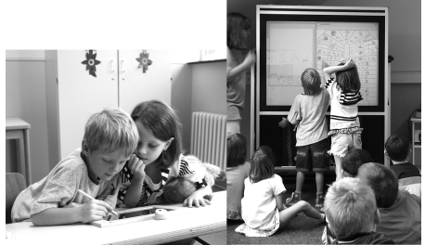
Background
Integration of natural environment with technology is referred to as “ubiquitous computing”.
One such example is the European NIMIS project
U. Hoppe, A. Lingnau, I. Machado, A. Paiva, R. Prada, and F. Tewissen, “Supporting Collaborative Activities in Computer Integrated Classrooms-the NIMIS Approach,” IEEE CS Press, 2000.

Slide 8
Description of the Invention
8

Slide 9
Description of the Invention
In educational settings, students spend as much as 70% of their time sitting, mostly in classrooms.
That prompted us to look at the innovation in where we spend the most time doing.
As the name suggests, AI-Based Digital Screen-Integrated Tables for Educational Settings, we will be integrating tables with digital screens essentially integrating the technology with the environment.
P. Schwenke and M. Coenen, “Influence of Sit-Stand Tables in Classrooms on Children’s Sedentary Behavior and Teacher’s Acceptance and Feasibility: A Mixed-Methods Study,” Int J Environ Res Public Health, vol. 19, no. 11, Jun. 2022, doi: 10.3390/ijerph19116727
9

Slide 10
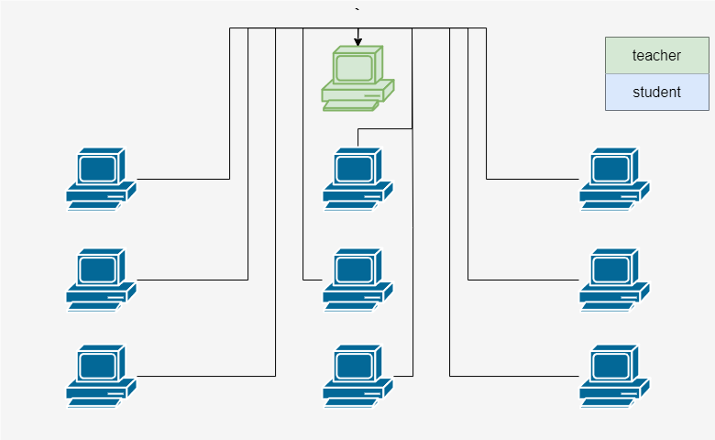
Description of the Invention
We propose a networked computer system, where all the display’s are synchronized by a mother computer accessed by the faculty i.e., the teacher.
P. Schwenke and M. Coenen, “Influence of Sit-Stand Tables in Classrooms on Children’s Sedentary Behavior and Teacher’s Acceptance and Feasibility: A Mixed-Methods Study,” Int J Environ Res Public Health, vol. 19, no. 11, Jun. 2022, doi: 10.3390/ijerph19116727
10

Slide 11
Description of the Invention
Similar to the European NIMIS project, we would have a customized software to facilitate efficient data collection.
The digital screen can be used to display the text books, live lectures, problem solutions, exam questions, give class doubts, or even games such as quizzes etcetera.
This leads to a collaborative environment in educational settings.
P. Schwenke and M. Coenen, “Influence of Sit-Stand Tables in Classrooms on Children’s Sedentary Behavior and Teacher’s Acceptance and Feasibility: A Mixed-Methods Study,” Int J Environ Res Public Health, vol. 19, no. 11, Jun. 2022, doi: 10.3390/ijerph19116727
11

Slide 12
Description of the Invention
Promotes inclusion of Person with disabilities, as someone who can not hear (deafness) can look at the live transcription in class, showcasing the power of technology.
12

Slide 13
Advantages of this Invention
13

Slide 14
Advantages of this Invention
Essentially deals with the sluggish adoption of technology in educational settings.
Promotes utilization of state-of-the-art AI to make better sound decisions.
Promotes inclusiveness of different person with disabilities.
Helps in identifying slow learners and fast learners.
P. Schwenke and M. Coenen, “Influence of Sit-Stand Tables in Classrooms on Children’s Sedentary Behavior and Teacher’s Acceptance and Feasibility: A Mixed-Methods Study,” Int J Environ Res Public Health, vol. 19, no. 11, Jun. 2022, doi: 10.3390/ijerph19116727
14

Slide 15
Patent Claims

Slide 16
Patent Claims
A system for educational settings comprising a display integrated into a table, wherein said display is capable of presenting educational as well as other multi-media content to users.
The system of claim 1, wherein multiple tables are connected together in a network to facilitate collaborative learning experiences in educational settings.
The system of claim 2, further comprising software installed on the display-integrated table for gathering data from users at frequent intervals.
The system of claim 3, wherein said gathered data is processed using machine learning algorithms to assess user performance and provide insights for decision-making by educators.

Slide 17
Summary of the Invention

Slide 18
Summary of the Invention
The invention addresses for the need of a data-driven learning experiences for the classroom of 21st century, wherein traditional furniture are integrated with a digital screen or a synchronized display.
The innovation promises to promote collaboration, efficient data collection, and sound decision making.
The key features of the innovation includes every tables to have their own display for individual students, regular collection of data from the students, and utilization of machine learning algorithms to identify slow learners and fast learners.

Slide 19
Summary of the Invention
The unique design and functionality of the digital screen-integrated table represents a significant advancement in educational technology, offering benefits for students, teachers, and educational institutions.

Slide 20

Thank You
We are open to
Questions
Sagar Tamang The Assam Kaziranga University
cs22bcagn033@kazirangauniversity.in

